Slide 1



Tools

Slide 2
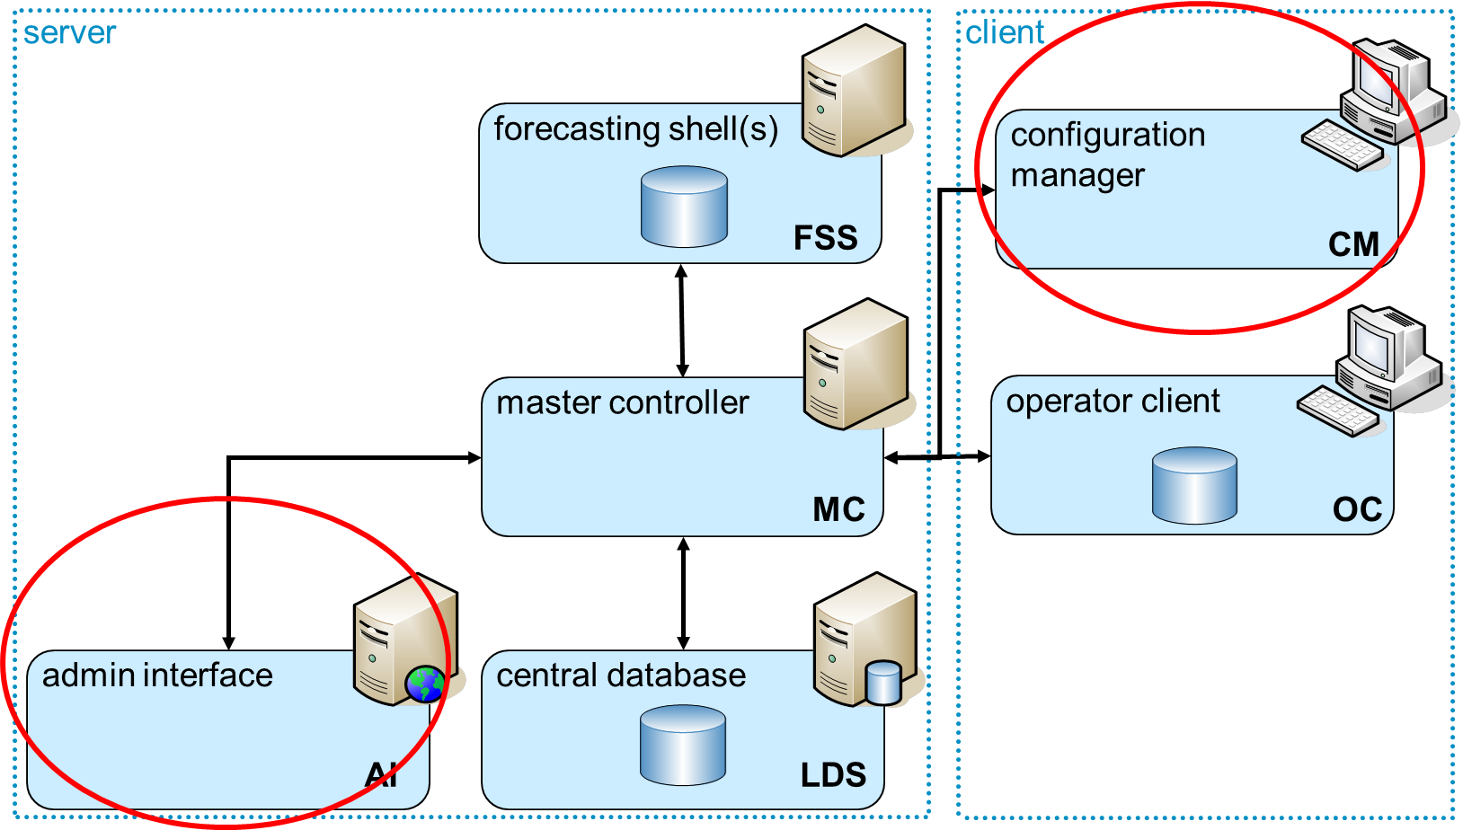
Tools
Workflow Navigator
Database Viewer
Diplays
WIKI
XML Spy, oXygen
creating, editing, validating (schema)
_________________________________________________________
FEWS Configuration manager (special class in OC)
Managing the (operational) configuration
Distribute through the database(s)
Admin interface (Web application)
System Management
Scheduling tasks/workflows
Health checking

Slide 3
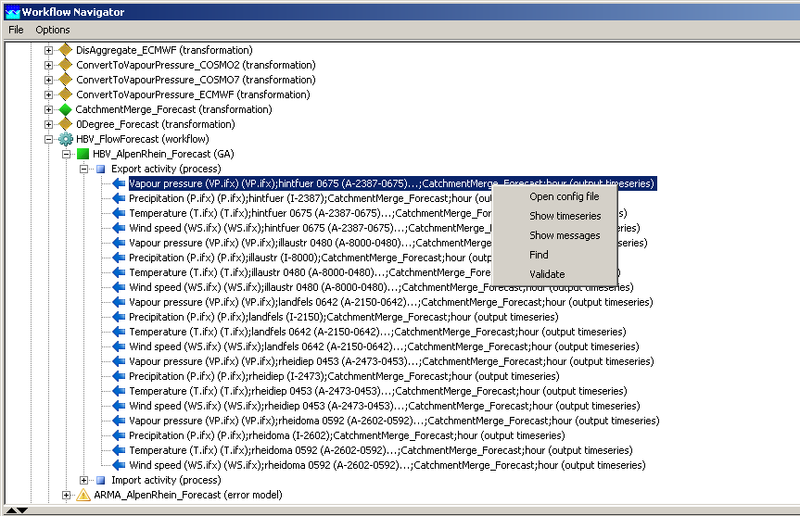
Tools – Workflow Navigator
Check configuration step by step
helps you finding errors in the configuration
Demonstration

Slide 4
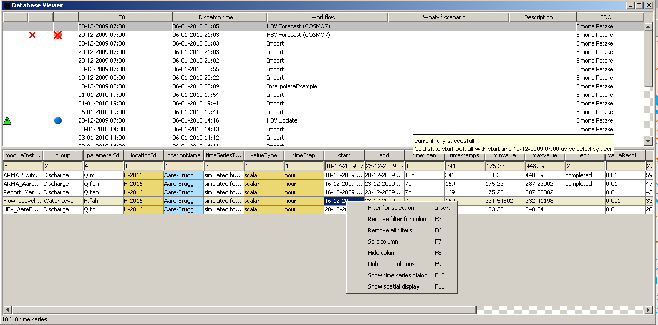
Tools – Database Viewer
Check what has actually been imported to your local data store
helps you finding errors in the configuration
Demonstration

Slide 5
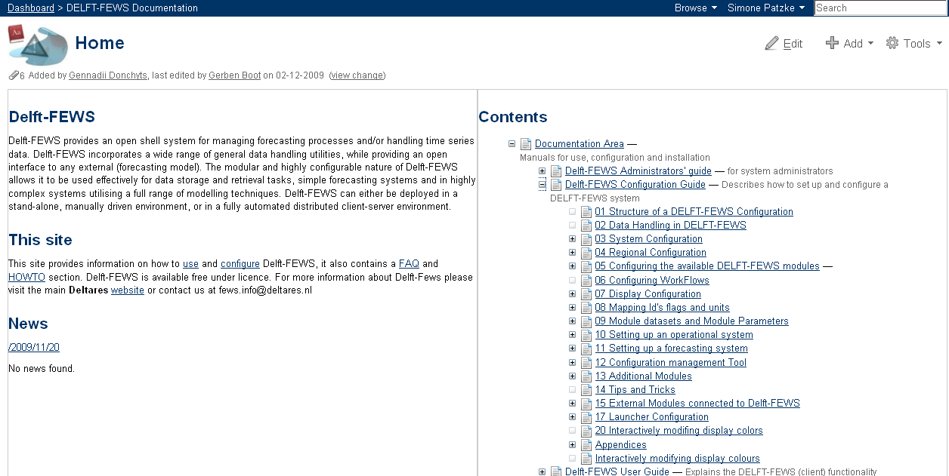
Tools - WIKI
Documentation on Public Wiki
http://public.wldelft.nl/display/FEWSDOC
Demonstration

Slide 6
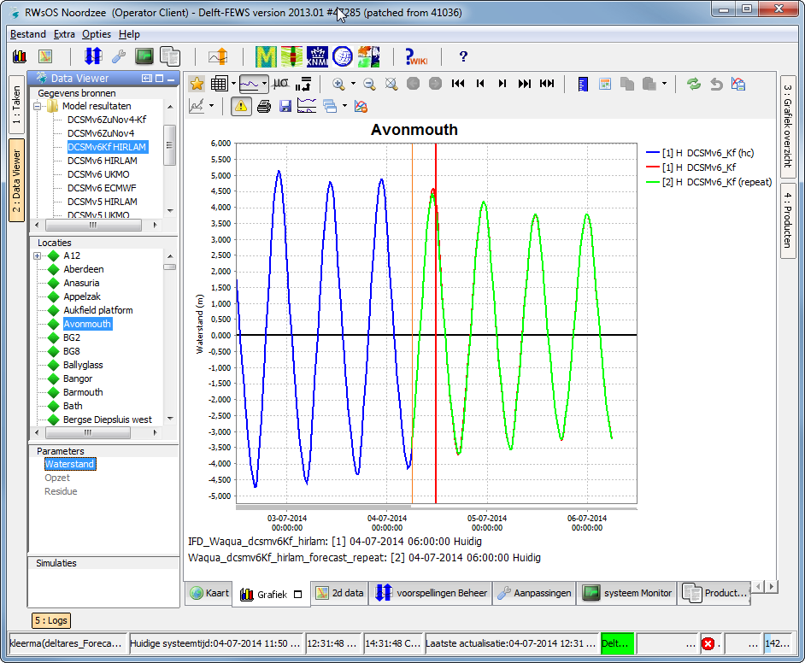
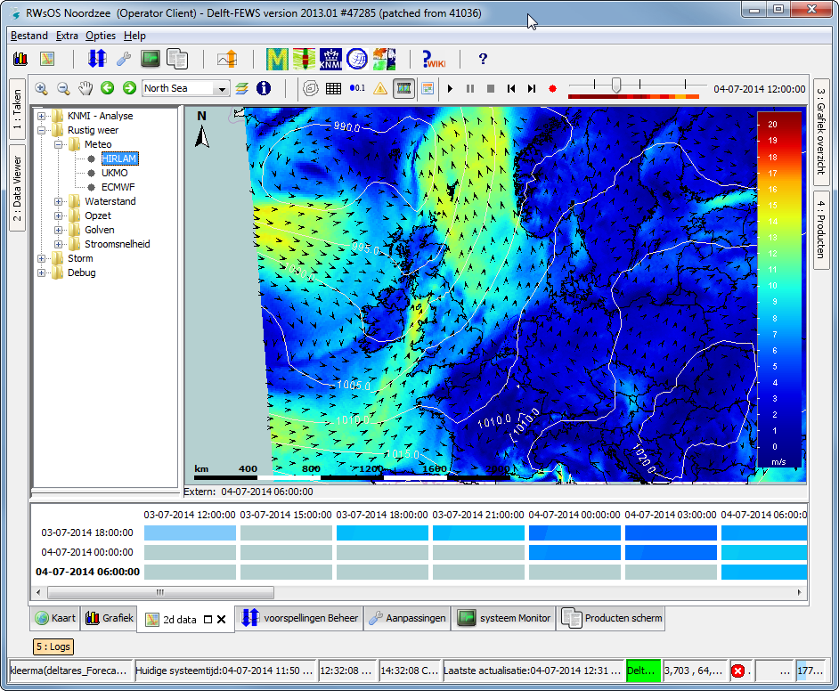
Tools - Displays
Exercises tomorrow

Slide 7
Tools – Configuration Manager
Management of the configuration files
To the central database
update XML-files
import to OC
validate changes
upload config change to MC
To the file system
download configuration to OC
export from OC to file system
go to 1
central database
e.g. oracle
5
4
user
local datastore
3
OC
6
2
files
Demonstration tomorrow
1

Slide 8
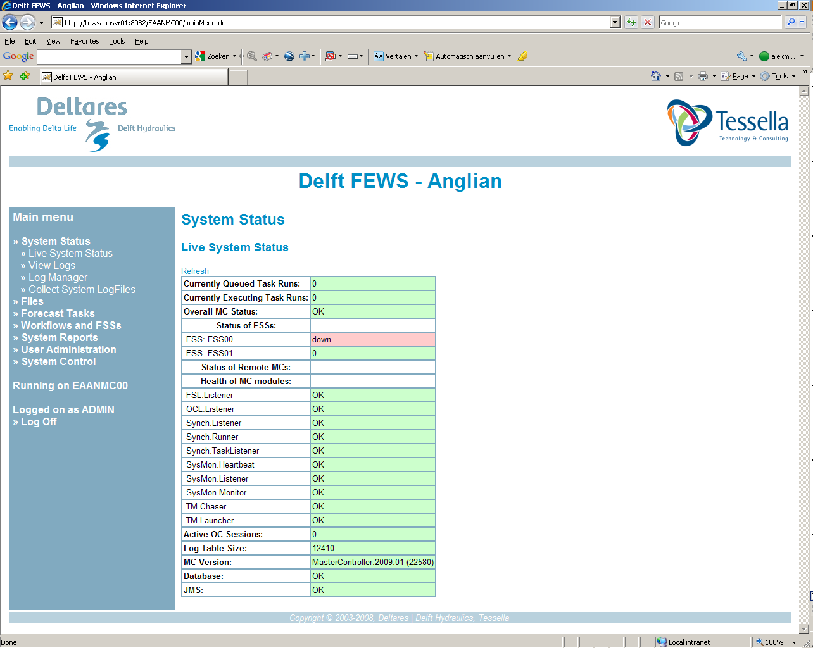
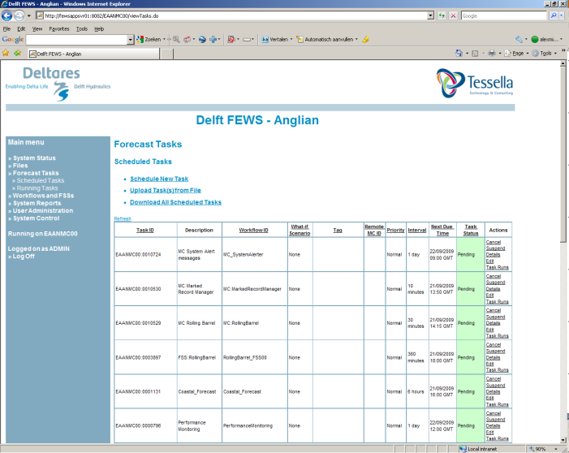
Tools – Admin Interface
Administration tool for live system
Direct access to Central Database
Main tasks
Monitoring (health) of live system components
Scheduling of tasks (current!)
Monitoring of task queues
Management of Forecasting Shell Servers
Setting enhanced forecasting etc.
Demonstration
tomorrow

